Slide 1
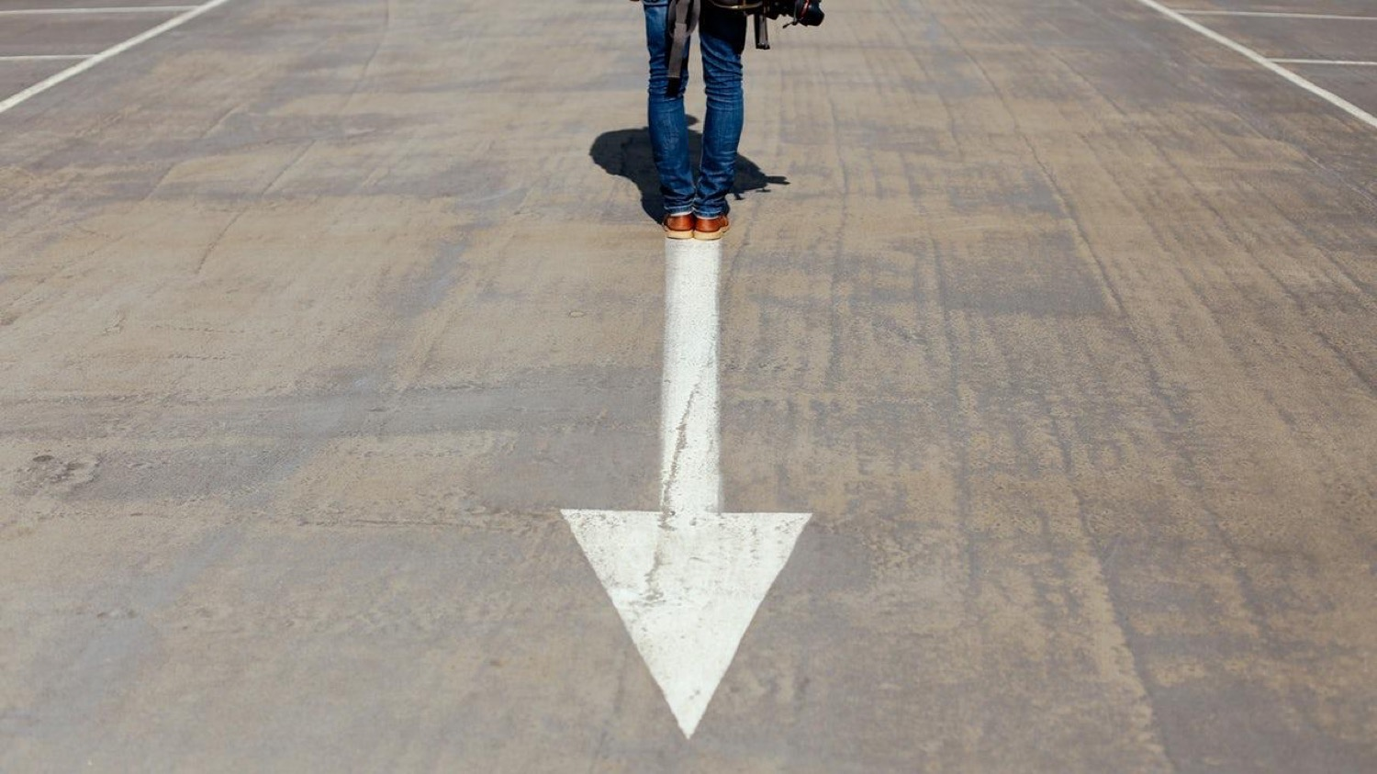

Ph0to Background presentation

Slide 2
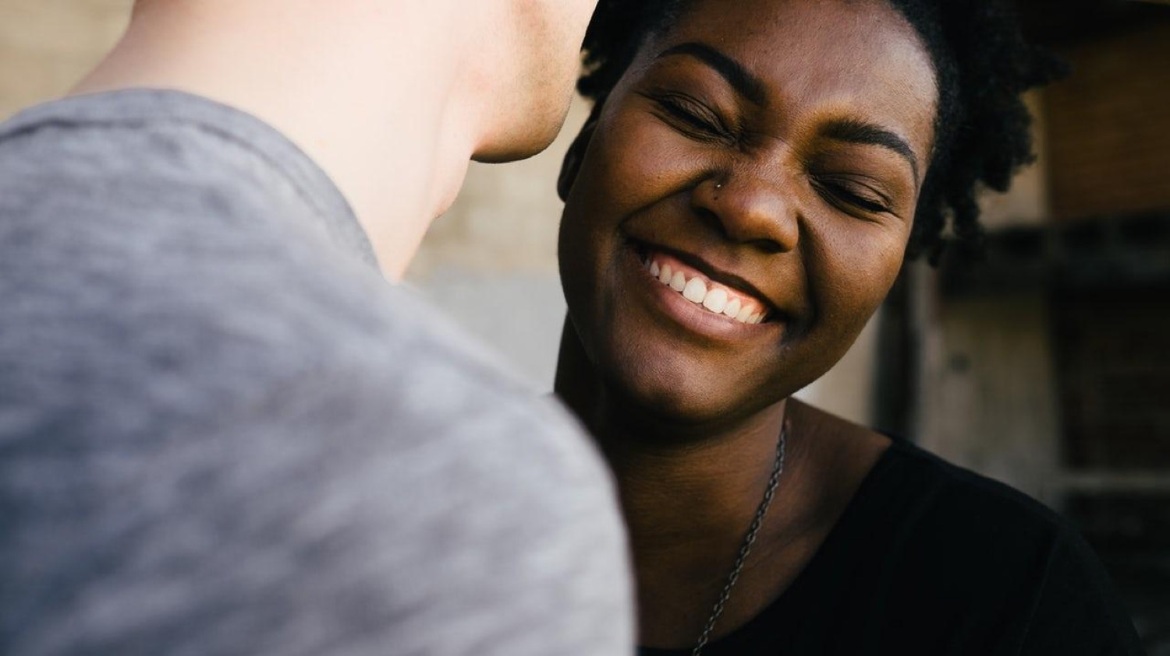
Hello!
I am Jayden Smith
I am here because I love to give presentations.
You can find me at @username

Slide 3

1.
Transition headline
Let’s start with the first set of slides

Slide 4
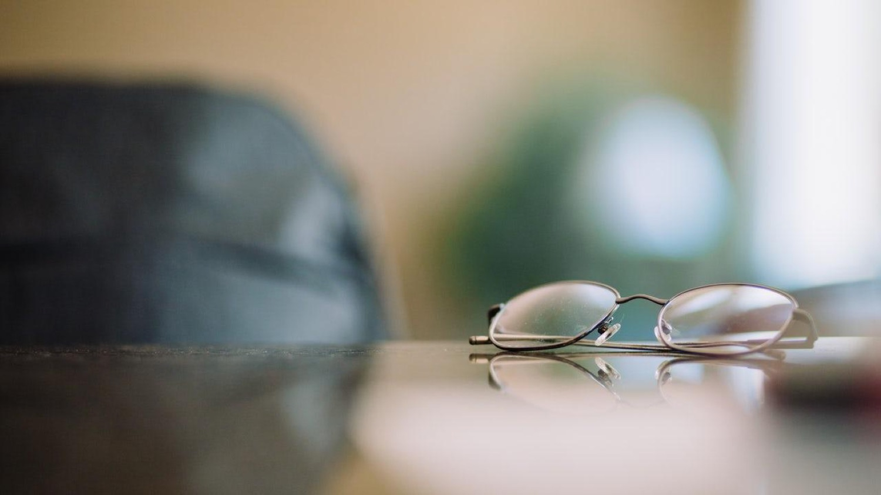
This is a slide title
Here you have a list of items
And some text
But remember not to overload your slides with content
Your audience will listen to you or read the content, but won’t do both.

Slide 5
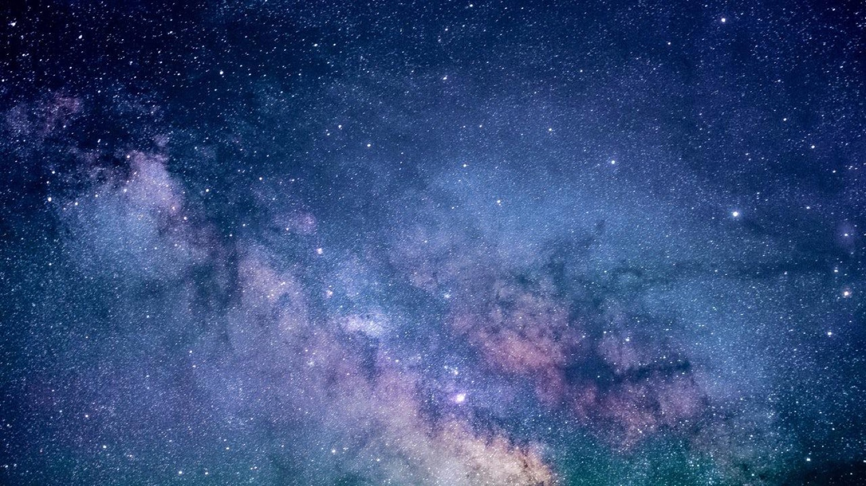
BIG CONCEPT
Bring the attention of your audience over a key concept using icons or illustrations

Slide 6
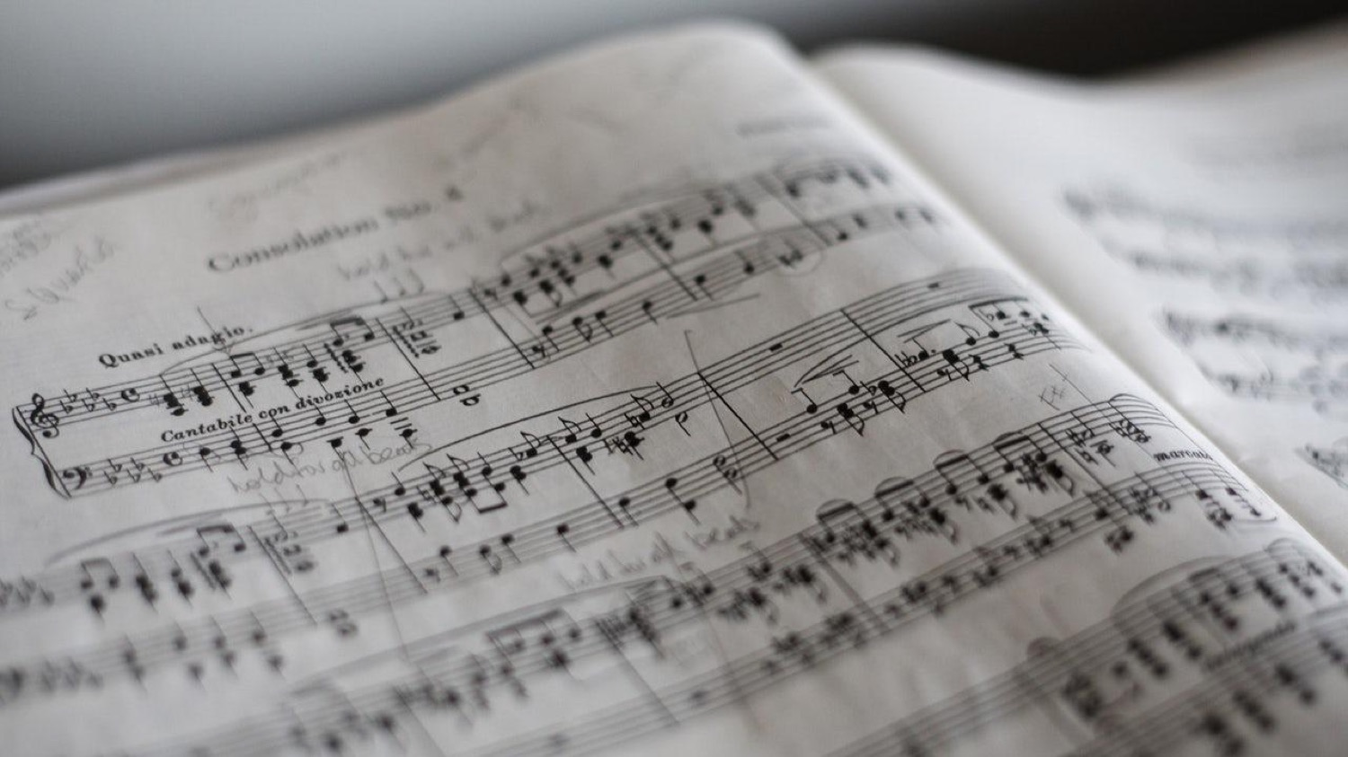
You can also split your content
White
Is the color of milk and fresh snow, the color produced by the combination of all the colors of the visible spectrum.
Black
Is the color of coal, ebony, and of outer space. It is the darkest color, the result of the absence of or complete absorption of light.

Slide 7
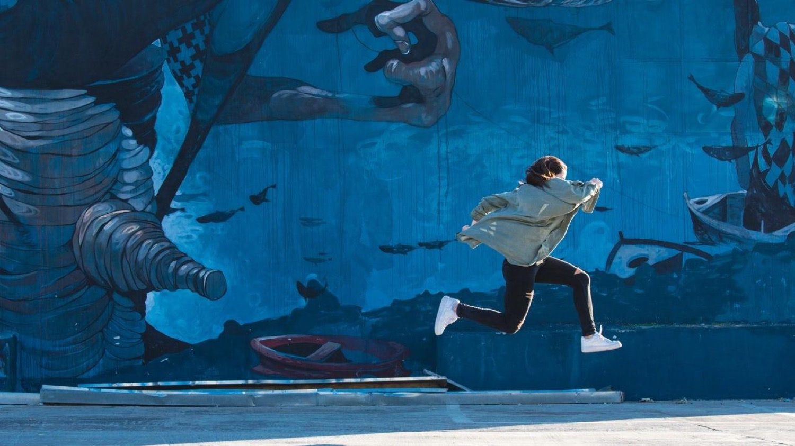
A picture is worth a thousand words
A complex idea can be conveyed with just a single still image, namely making it possible to absorb large amounts of data quickly.

Slide 8

And tables to compare data
 | A | B | C
Yellow | 10 | 20 | 7
Blue | 30 | 15 | 10
Orange | 5 | 24 | 16

Slide 9

Maps
our office

Slide 10

89,526,124
Whoa! That’s a big number, aren’t you proud?

Slide 11
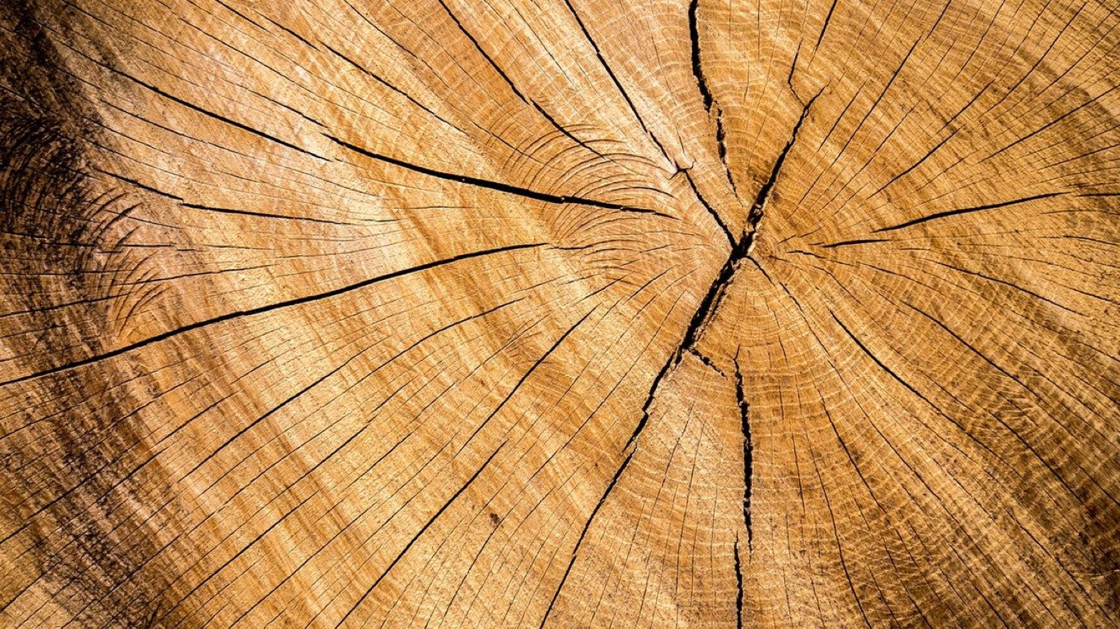
Our process is easy
1.
first
2.
second
3.
last

Slide 12
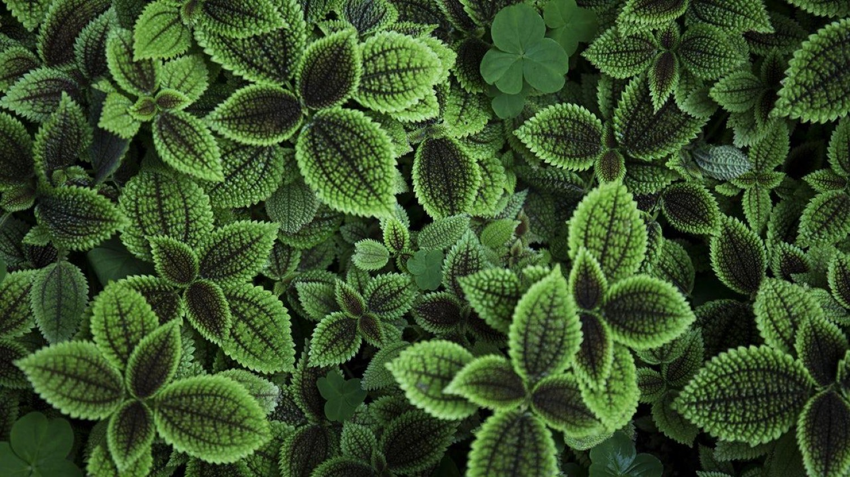
Let’s review some concepts
Yellow
Is the color of gold, butter and ripe lemons. In the spectrum of visible light, yellow is found between green and orange.
Blue
Is the colour of the clear sky and the deep sea. It is located between violet and green on the optical spectrum.
Red
Is the color of blood, and because of this it has historically been associated with sacrifice, danger and courage.
Yellow
Is the color of gold, butter and ripe lemons. In the spectrum of visible light, yellow is found between green and orange.
Blue
Is the colour of the clear sky and the deep sea. It is located between violet and green on the optical spectrum.
Red
Is the color of blood, and because of this it has historically been associated with sacrifice, danger and courage.

Slide 13

Desktop project
Show and explain your web, app or software projects using these gadget templates.
Place your screenshot here

Slide 14
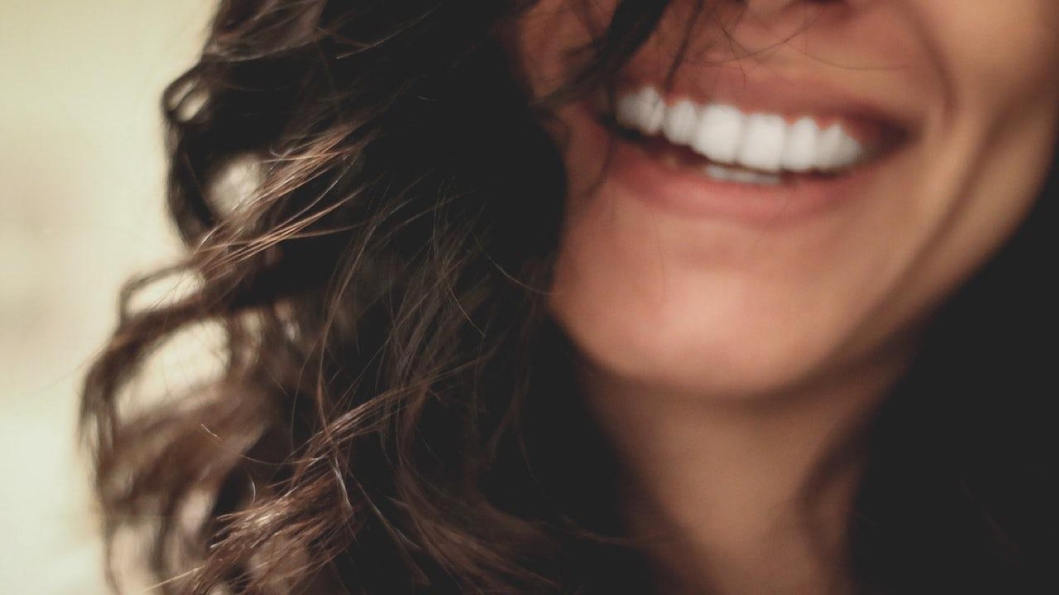
Thanks!
Any questions?
You can find me at:
@username
user@mail.me

Slide 15

Credits
Special thanks to all the people who made and released these awesome resources for free:
Presentation template by SlidesCarnival
Photographs by Unsplash

Slide 16
SlidesCarnival icons are editable shapes.
This means that you can:
Resize them without losing quality.
Change line color, width and style.
Isn’t that nice? :)
Examples:

